Slide 1
“Plastic Waste in Canada”:
Strategies and Insight for Reducing Environmental Impact
Ibrahim T, Jay L, Thais C, Ali

Slide 2
Plastic Waste in Canada: An Introduction
Growing concern in Canada and globally
Millions of metric tons end up in landfills and oceans
Harms wildlife, ecosystems, and contributes to pollution
Strategies: prevent collateral waste, alternative materials, circular economy, recycling tech
Innovative solutions in Canada: ML tech, product design changes by corps like Starbucks
Let's work towards a sustainable and circular economy by reducing plastic waste.
Notes:
Hey everyone, it is my pleasure to welcome you to this presentation on the problem of plastic waste in Canada. The issue of plastic waste and its impact on the environment has become a growing concern in recent years, with increasing awareness of the devastating effects it has on our planet and its inhabitants. The numbers are staggering: millions of metric tons of plastic ending up in landfills and oceans each year, causing harm to wildlife and ecosystems, and contributing to greenhouse gas emissions and other forms of pollution. This report explores the strategies being used to reduce plastic waste in Canada, highlighting examples of organizations and companies that are leading the way in tackling this problem. Our goal is to raise awareness, share information, and inspire action towards a more sustainable and circular economy in Canada and beyond.
So, let us begin by providing an overview of the issue and its impact on the environment.

Slide 3
II. Overview of Plastic Waste
How much do you know about plastic? Plastics are :
Synthetic or semi-synthetic material that use polymers as a main ingredient
Benefits: lightweight, easy process, cheap cost, durability, and corrosion and moisture resistance
Known to be a material that can be recycled.
How much plastic waste is made?

Slide 4
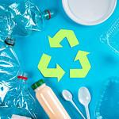
How much plastic is being recycled?
What is the first thing that comes to your mind when you think of plastic?
Despite how plastic is promoted,
Only 9% of the plastic produced are recycled.
So what happens to used plastics?
PHOTO CREDIT : https://www.flickr.com/photos/30478819@N08/51095593162

Slide 5
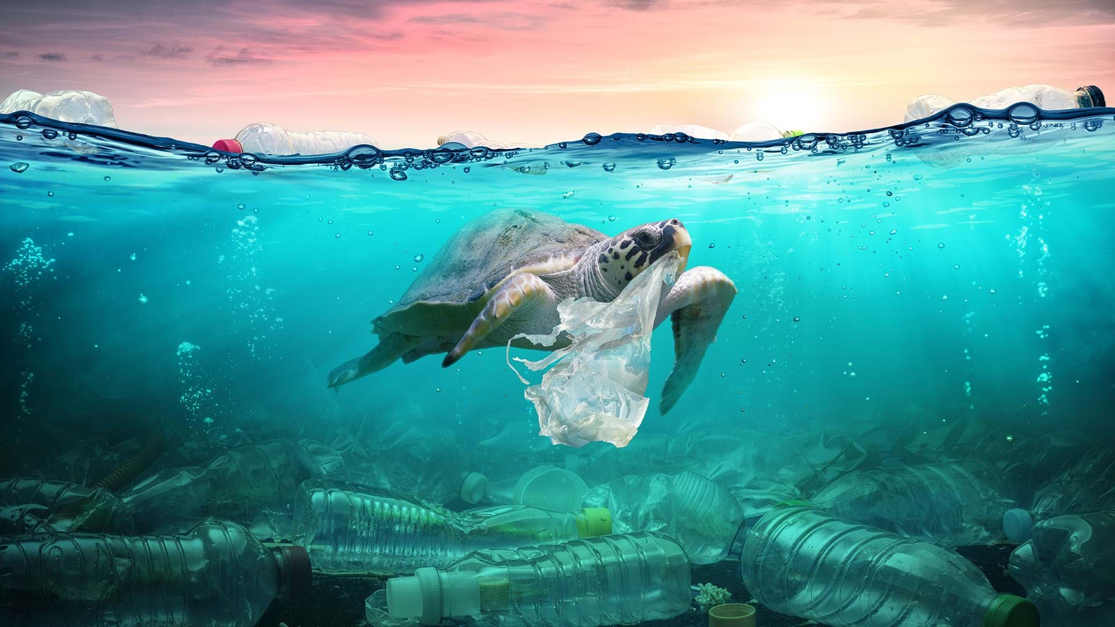
91 Percent of the plastic goes…
Ocean: Approximately 13 million metric tons of plastic end up in the ocean every year. This is equivalent to 2 garbage truck full of plastic every minute.
Land: Out of 8.3 billion tons of plastic that is produced, 6.3 billion ton ends up in a landfill. But how much time will it take for plastic to degrade?
Photo credit: https://www.condorferries.co.uk/plastic-in-the-ocean-statistics

Slide 6
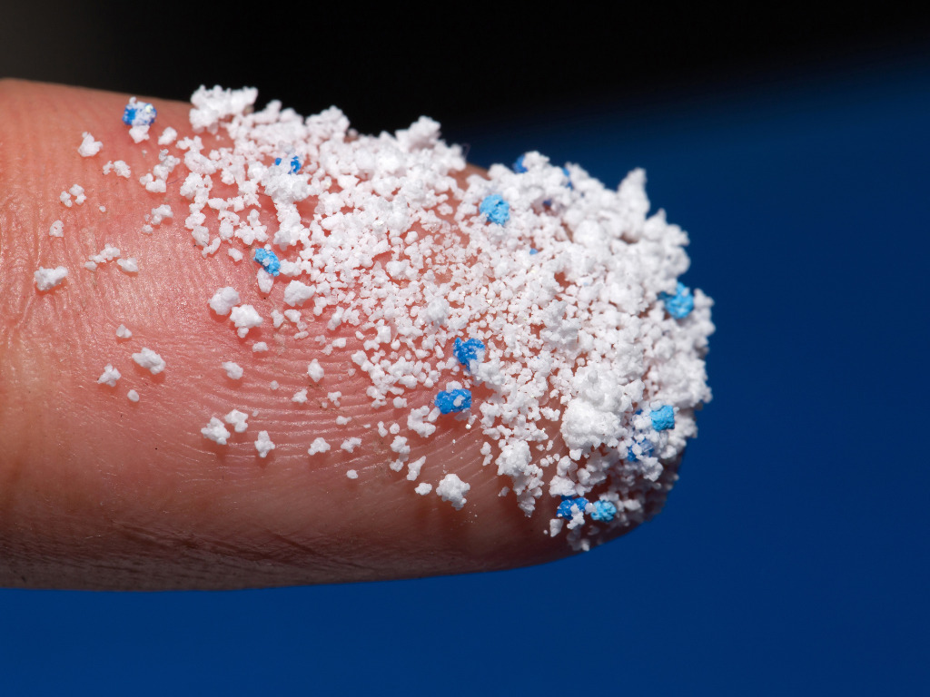
Degrading plastic and microplastics
Plastic may take up to 1,000 years to degrade. Water bottle we see daily take up to 450 years to decompose.
Even after degrading, plastic becomes micro-plastic that destroys terrestrial and ocean life.
For humans, in extreme case it is possible to consume plastic size of a credit card in one year.
If we are dumping plastic in to ocean and land when it takes hundreds of years to decompose, is this sustainable? Photo credit: https://www.greenqueen.com.hk/10-terrifying-facts-microplastics/

Slide 7
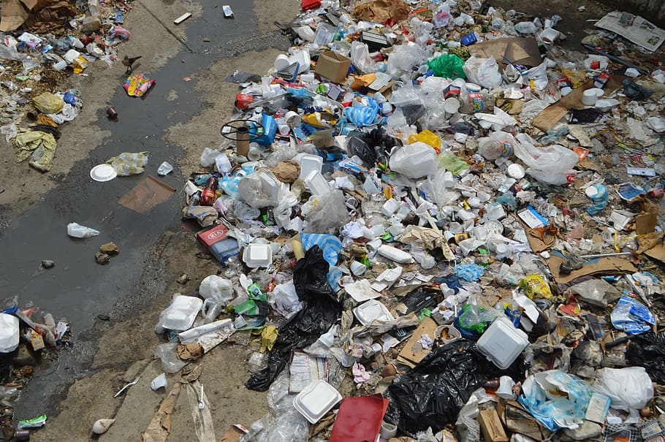
How much space does plastic take up?
Since it takes plastic centuries to degrade, the speed of it decomposing has not been catching up to the amount we are dumping away every year.
It is projected that the ocean’s surface will be covered by plastic by 2040 and not too far beyond that time for our land.
One alternative for degrading plastic is by burning them, but plastic releases dangerous substances such as heavy metals and POP (Persistent organic pollutants).
Photo credit: https://www.pxfuel.com/en/free-photo-orkvc

Slide 8
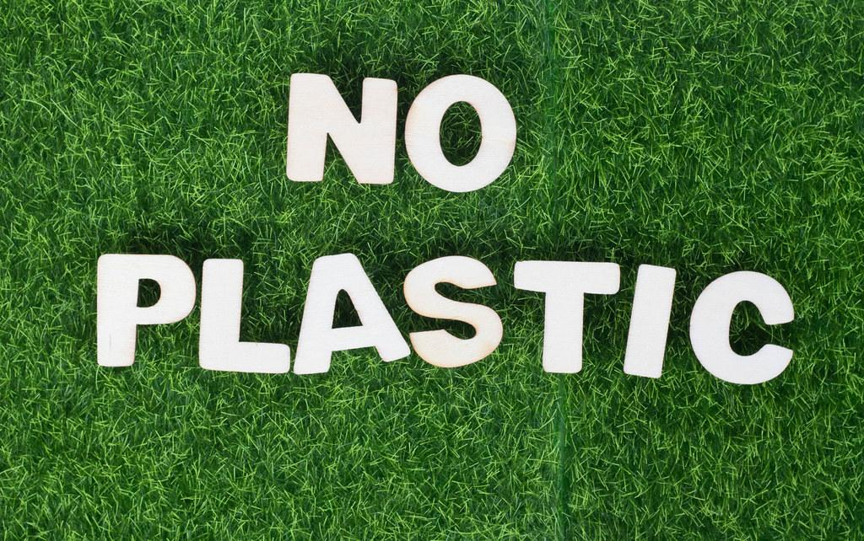
III. Plastic Waste Reduction Strategies
Photo credit: https://www.flickr.com/photos/30478819@N08/48329288151
Reducing plastic waste
2. Substituting plastic

Slide 9

Reducing plastic waste
In some industries, plastic usage is inevitable.
Associations such as SME has been working on machine learning technology to reduce plastic waste in industries such as manufacturing industry where plastic usage is mandated.
This approach is used when a firm or industry can not find a replacement for plastic usage.
Photo credit: https://zeorouteplanner.com/blog/how-zeo-route-planner-is-helping-smes-grow/

Slide 10


Substituting plastic
Great example for this approach of plastic reduction is Starbucks.
Notice how recent starbucks cups and straws are not the same as before?
This approach reduces plastic usage by substituting plastic with other materials.
Photo credits
Frappuccino: https://commons.wikimedia.org/wiki/File:Starbucks_-_Coffee_Frappuccino_%2851259869202%29.jpg
Straw-less lid: https://www.pexels.com/photo/a-person-holding-an-iced-coffee-13397809/

Slide 11
IV. Plastic Waste Reuse Strategies
Canada generates significant plastic waste each year, and finding effective ways to reuse it is crucial.
Circular economy models and initiatives aim to keep materials in use and reduce waste generation.
The Recycling Council of Ontario (RCO) promotes sustainable supply chains, product stewardship, recycled materials, and new markets for plastic waste reuse.
Innovative recycling technologies like blockchain-enabled exchange (Plastic Bank) and chemical recycling (Pyrowave, GreenMantra Technologies) have been developed in Canada.
Successful initiatives include the City of Vancouver's Zero Waste program, which promotes waste reduction and diversion, and the Ocean Plastics Charter, which aims to prevent plastic waste flow into the ocean and promote sustainable plastic use.
Diverse plastic waste reuse strategies in Canada are crucial in reducing plastic waste and promoting sustainable resource use, providing a pathway towards a more sustainable future.
Notes:
Before:
Now that we've discussed plastic waste reduction in Canada, let's look at plastic waste reuse strategies in Canada and also the Zero Waste program here in Vancouver.
Script:
Canada generates a significant amount of plastic waste each year, but there are various strategies that have been developed to promote a circular economy and reduce waste. Circular economy models and initiatives have become increasingly popular in Canada, aiming to keep materials in use for as long as possible and reduce waste generation. The Recycling Council of Ontario has been advancing the circular economy in Ontario through various initiatives and programs, such as promoting the development of sustainable supply chains and advocating for product stewardship. They also emphasize the importance of using recycled materials and developing new markets for them, creating opportunities for plastic waste reuse in Canada. Innovative recycling technologies and processes have also been developed, such as The Plastic Bank, a social enterprise that uses blockchain technology to enable the exchange of recycled plastic for goods and services, and Canadian companies like Pyrowave and GreenMantra Technologies, which have developed innovative technologies to recycle plastic waste and create new products from it.
Several successful plastic waste reuse initiatives have been implemented across Canada, such as our very own City of Vancouver's Zero Waste program that promotes waste reduction and diversion through education and outreach and implements policies such as a ban on single-use plastic straws. In addition, the Ocean Plastics Charter, signed by Canada and other countries in 2018, aims to prevent the flow of plastic waste into the ocean and promote sustainable plastic use.
So, as you can see, plastic waste reuse strategies in Canada are diverse and include circular economy models and initiatives, innovative recycling technologies and processes, and successful case studies of plastic waste reuse initiatives. These approaches are crucial in reducing plastic waste and promoting sustainable resource use, providing a pathway towards a more sustainable future.
Now, I am going to play a short video on Vancouvers Zero Waste Program.

Slide 12
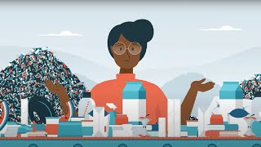
“Vancouver Zero Waste Demonstration Site: Supporting Zero Waste Innovation.” YouTube, YouTube, 13 Dec. 2022, https://www.youtube.com/watch?v=BdRxf0ZuAeQ&t=7s. Accessed 4 Apr. 2023.

Slide 13
V. Challenges and Opportunities
Growing plastic waste a challenge for Canada.
Canadian Plastic Innovation Challenges to incentivise the development of technology to address plastic.
9% of the plastic produced are recycled.
Eliminating unnecessary use of single used plastic.
Need funds to set up recycling facility.
Week policy support.
Phase 1 action plan focused on product design, single used plastic , recycling capacity, collection system.
Phase 2 action plan focused on consumer awareness, aquatic activities, research and monitoring.

Slide 14
VI. Conclusion - Moving Forward
Millions of metric tons of plastic waste end up in landfills and oceans each year in Canada.
Only 9% of plastics produced are recycled, and it can take up to a thousand years to degrade in a landfill.
Environmental impacts include pollution, harm to wildlife, and greenhouse gas emissions.
Strategies to reduce plastic waste in Canada include preventing collateral waste, replacing plastic with sustainable materials, and innovative recycling technologies.
Successful examples include machine learning and sustainable materials.
Awareness is crucial to a more sustainable and circular economy.
Let's collaborate to reduce plastic waste, protect our environment, and move towards a sustainable future.

Slide 15
Questions/Comments?

